Slide 1
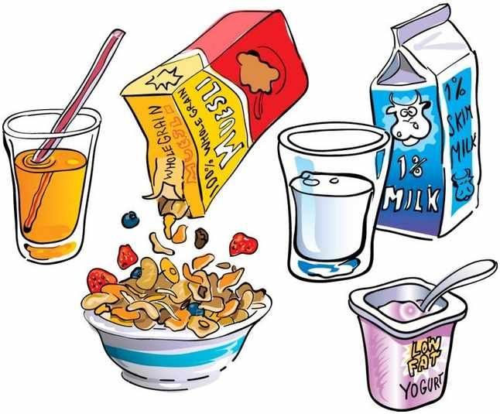
Breakfast

Slide 2
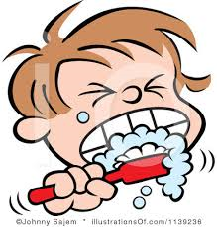
Brush Teeth

Slide 3
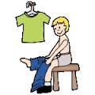
Get Dressed

Slide 4
Work at table

Slide 5
Crafts / Colouring

Slide 6
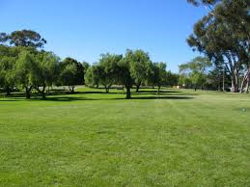
Outside

Slide 7
Exercises

Slide 8
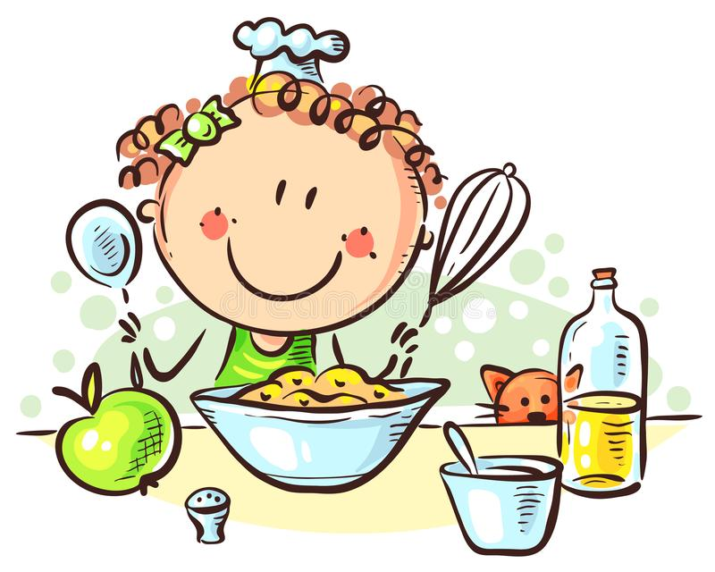
Cooking

Slide 9
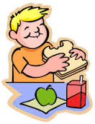
Lunch

Slide 10
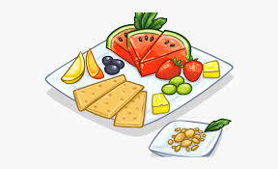
Snack

Slide 11
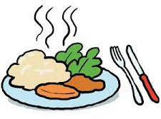
Dinner

Slide 12
Screen time / TV

Slide 13
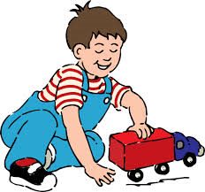
Play

Slide 14
Story / reading

Slide 15
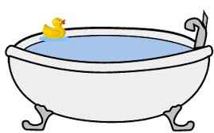
Bath

Slide 16
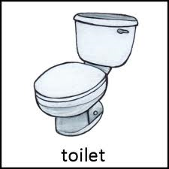
Toilet

Slide 17
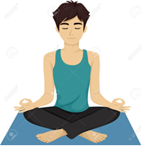
Relaxation / Yoga

Slide 18
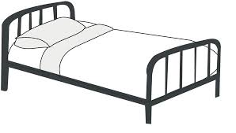
Bedtime

